Slide 1

PROJECT BASED LEARNING
NON-PROFIT ORGANISATION PORTAL
Essentials of Software Engineering
CS 17.208
SUBMITTED TO:
Mr. Hitesh Jangir
SUBMITTED BY:
NISHTHA AGARWAL(170425)
1

Slide 2
Basic Concepts of Software Engineering
Software is considered to be collection of executable programming code, associated libraries and documentations. Software, when made for a specific requirement is called software product.
Requirement Analysis
Planning
Coding
Testing and Maintenance
Documentation
Best Practices as Per RUP:
Develop Iteratively
Manage Requirements
Use component Architecture
Model Visually
Continuous Verification of Quality
Management of Change

Slide 3
Requirements and Methodologies
Functional Requirements:
One of the pages will contain information about the organization, agenda and motive. It will be a simple static page. The second page is a registration form for applying to open a sub NGO under the organization with or without a partnership. The third page leads to a donation portal which asks the user to enter his/her details and the specification of the object donated. The second and third page is connected to a backend.
The backend will consist of multiple tables. The first one will record the details entered to register for a new NGO. The second table will only be used if the user opts for a partnership as well. The third table will consist of information regarding the donor and the project donated.
The portal will also consist of a button on one of the pages that will enable the user to check the status of the registration of the NGO and also the status of the offered donation

Slide 4
Other Requirements:
1) Softwares: Xamppserver (front-end)
MySQL (back-end)
2) Images and text to support the portal
3) Languages used: HTML 5 , CSS , PHP, SQL
Constraints:
1) The portal is not region specific.
2) The donation portal can only be accessed by a citizen who is above 18 years of age (for this a valid government ID information will be taken)

Slide 5
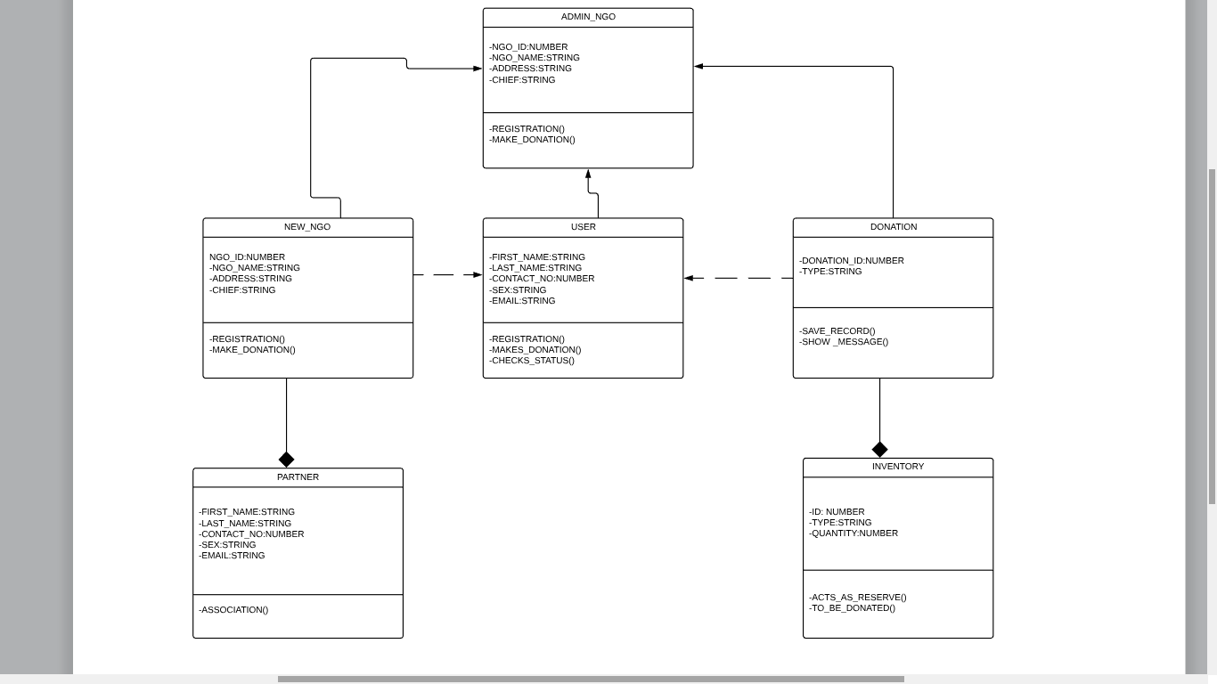
UML

Slide 6
Thank You!

